Slide 1
CRUD – CREATE & DELETE

Slide 2
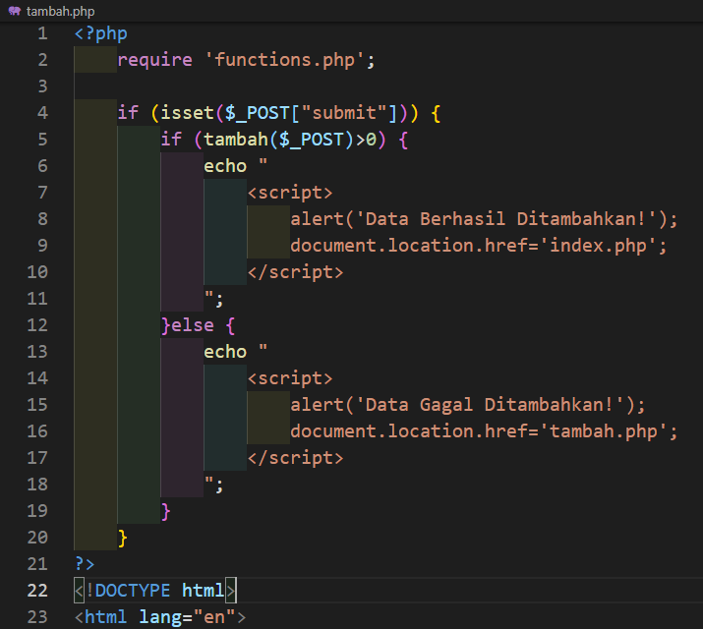
Tambah.php

Slide 3
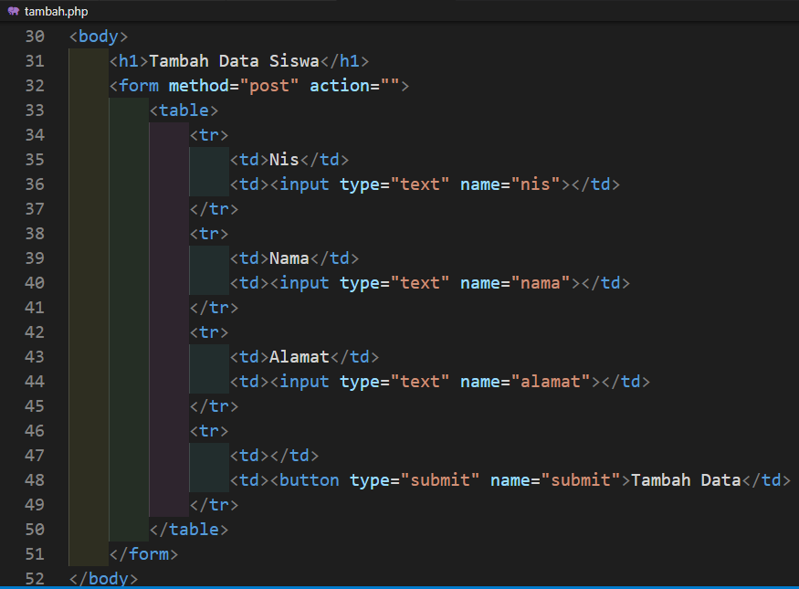
Lanjutan Tambah.php

Slide 4
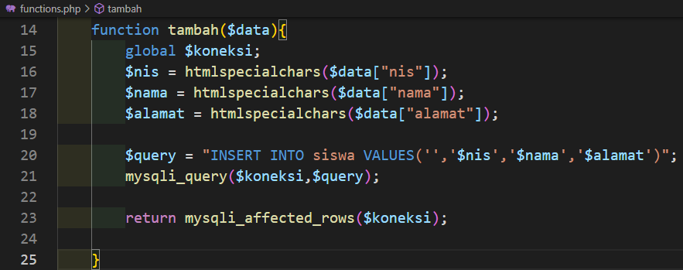
Function.php (function tambah)

Slide 5
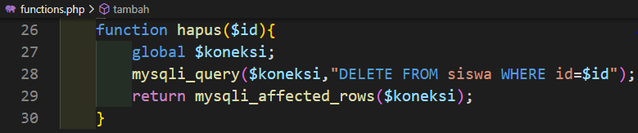
Function.php (function hapus)

